Slide 1

TraderX + VUU: Accelerating collaboration using GitHub Codespaces
Dov Katz
Cliff Tiltman
Chris Stevenson
@dovops
@ctiltman
@chrisjstevo

Slide 2
Important Tech Definition
MTTD: Mean Time to Detect
MTTD: Mean Time to Demo

Slide 3
TraderX: What and Why?
Industry relevant example
Generic, clean-IP for cross company collaboration
‘Something you might find in production …’
Accessible to any developer
Easy to demonstrate, etc.
Minimal pre-assumptions
Starting point for integrating/customizing
‘Show us what you mean – in code…’

Slide 4
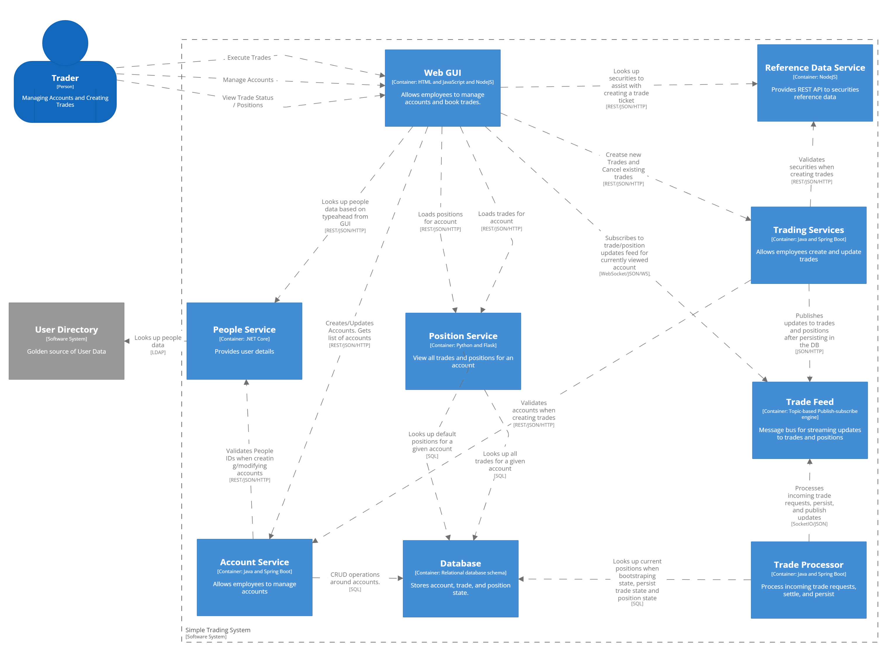
Quick Architectural Overview (1/2)

Slide 5
Quick Architectural Overview (2/2)
Small, simple(ish) codebases
Multiple independent microservices (but imagine as any distributed processes)
Currently as a monorepo
Something you can run in your IDE
‘Intentionally Chatty’
First working copy from a hackday.
Designed to extend

Slide 6
How did we build this?
VSCode (even for Java)
GitHub Codespaces
vscode.dev on top of public cloud compute
ngrok tunnels if needed
java/gradle, .net core, nodejs

Slide 7
Demo – traderX in Action

Slide 8
Intro to Vuu (vuu.finos.org)
What is Vuu?
A Client/Server UI framework for building trading and risk systems
It supports an in memory relational algebra engine for creating and joining tables…
… it allows you to only send the data you need to to the client (viewport + pre/post fetch)
Its supports advanced features, like indices on tables, treeing, aggregation, dynamic calculated columns….
….It is light on the client (~100Mb mem in electron)
Why do we need it?
Many good solutions in the street to UI problems
Banks have specific requirements for Uis, they want busy, compact UIs with lots of ticking
Vuu addresses those specific requirements in an open source project

Slide 9
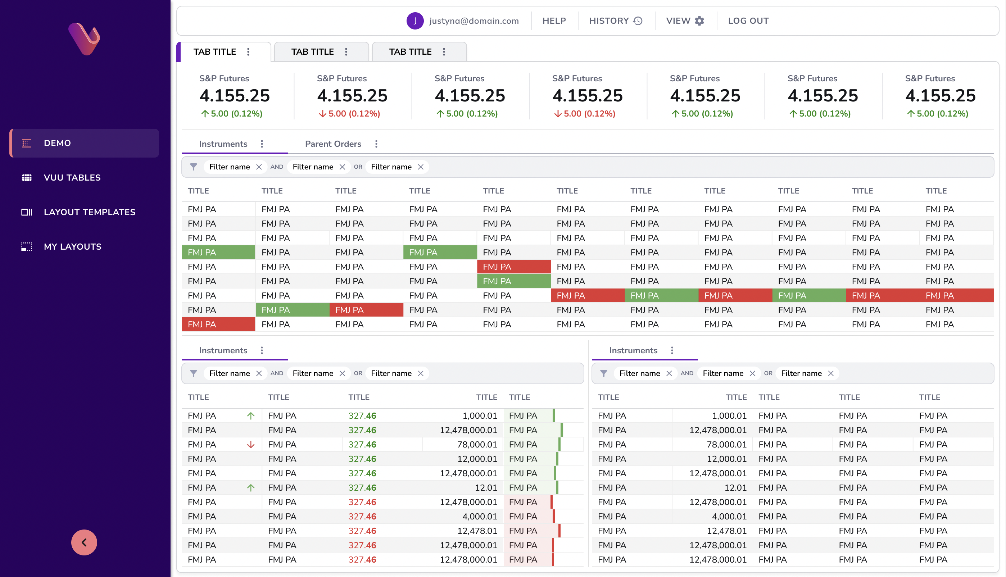
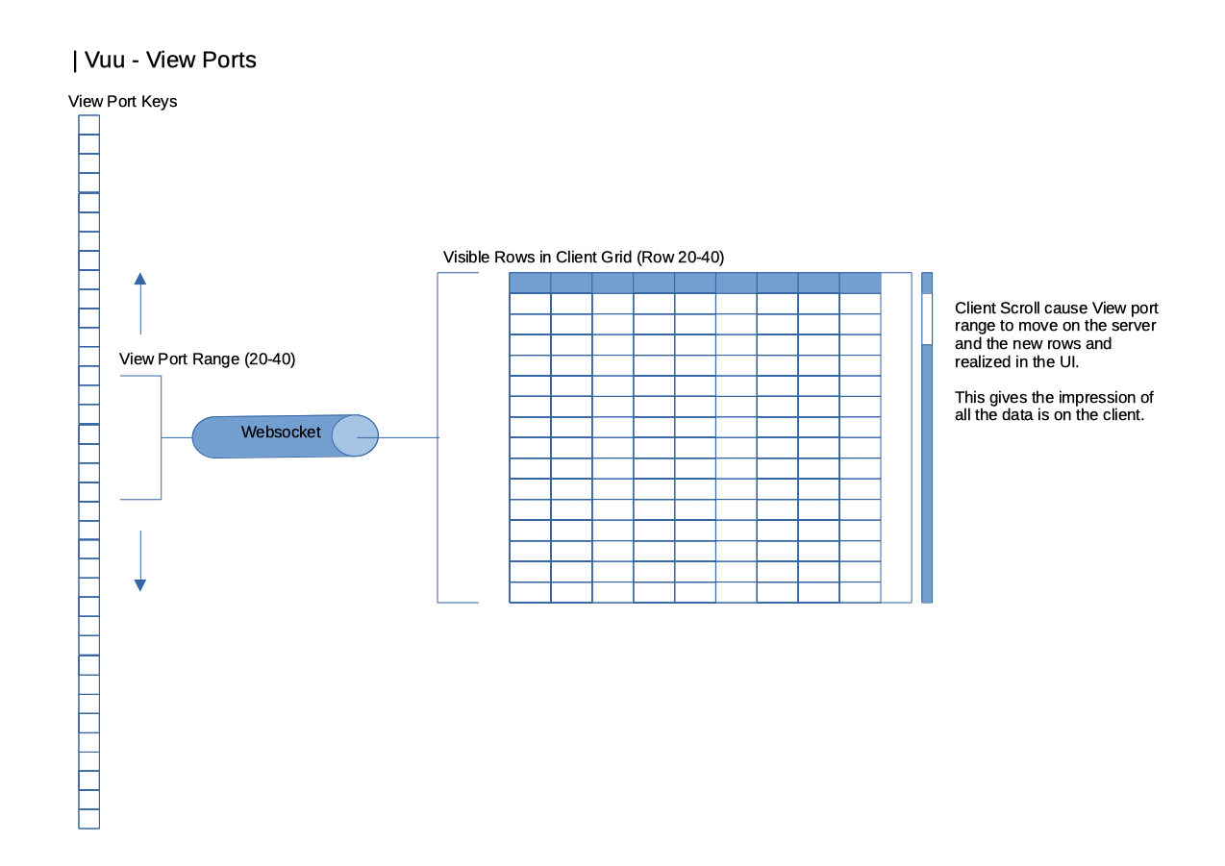
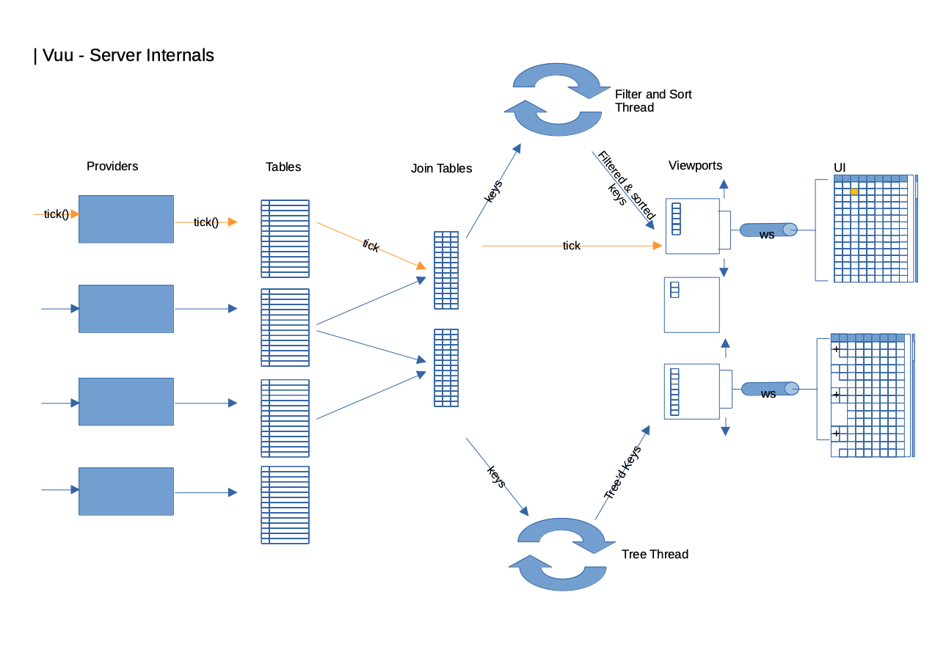
How Vuu fits into the architecture

Slide 10
Demo : traderX + vuu

Slide 11
Where else could this go…?
Limit checks using Morphir
Advanced data views using VUU
Apply CDM to the data exchanges
Integrate multiple screens/apps with FCD3
Create a Symphony chat bot using BDK/WDK
Try out new tech approaches
Demonstrate industry standards (Service mesh, Serverless, reach-out/back, etc). Experiment in the office, or at home.

Slide 12
What should we do next?
API Aggregator/gateway underneath web tier.
Improve documentation
Orderly start-up scripts, environment configuration
Extension lessons for containerization, etc
Hosted turn-key instance in a container (with code-server to locally develop)
Improve UX – Keep simple but make it more trading-like

Slide 13
Find out more
Git Repos
finos-labs/traderX
finos/vuu
More about Vuu
https://vuu.finos.org/
We encourage you to get involved!

